Slide 1
Brown Clusters
Many slides from Michael Collins

Slide 22
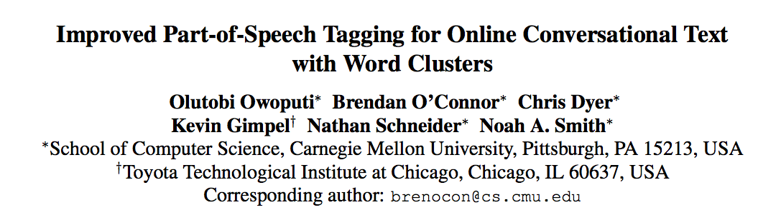
Owoputi et. al. ACL 2013

Slide 23
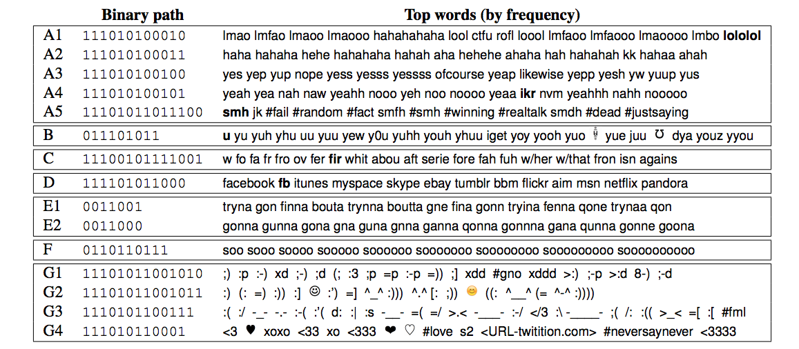
Owoputi et. al. ACL 2013

Slide 24
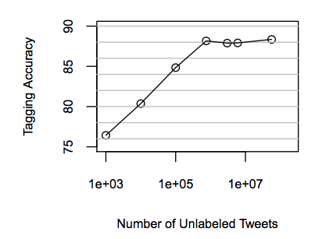
Owoputi et. al. ACL 2013

Slide 25
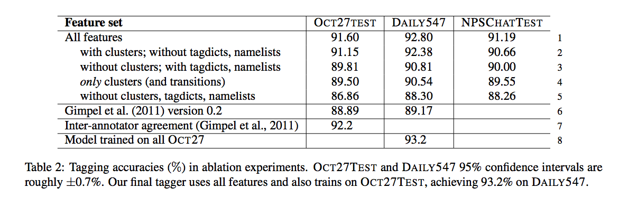
Owoputi et. al. NAACL 2013

Slide 26
Software for Brown Clusters
Percy Liang’s code: https://github.com/percyliang/brown-cluster
“A bit of progress in language modeling” Joshua Goodman
More sophisticated smoothing
JCLUSTER: http://research.microsoft.com/en-us/downloads/0183a49d-c86c-4d80-aa0d-53c97ba7350a/default.aspx

